Slide 1

Analyzing Sales Funnel for a Student Hostel Accommodation Chain
Aritra Basu
16/06/2023

Slide 2
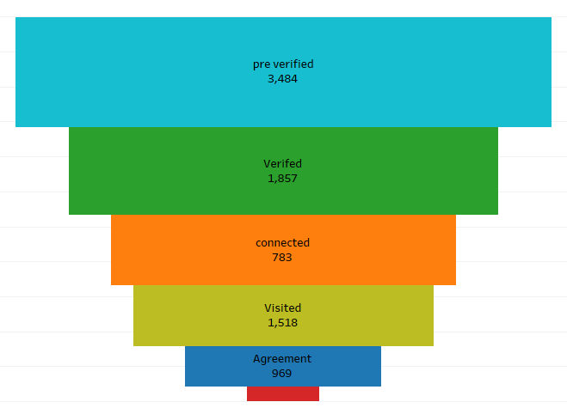
Sales Funnel and Summary
Summary:
After conducting a thorough Sales Funnel Analysis for Strent AH Pvt Limited (SAPL), we pinpointed the critical factors affecting their lead conversion ratio. Our findings highlight two main bottlenecks: a decline in the percentage of customer care team calls and a decrease in scheduled property visits by leads. By tackling these issues head-on and optimizing their customer acquisition process, SAPL has the opportunity to unlock significant growth and maximize conversion rates. Let's unleash the potential together

Slide 3
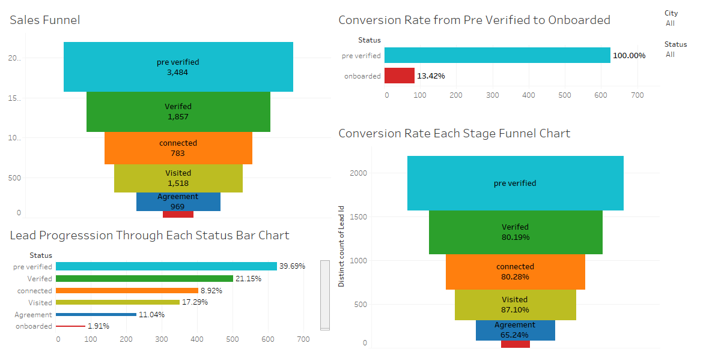


Sales Funnel Dashboard
To see the interactive dashboard click here

Slide 4
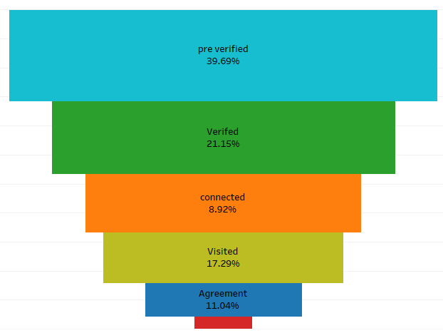
Lead Progression Through Each Status
From Exploration to Confirmation: Witness leads progressing through stages, with 39.69% staying in pre verified stage, rest entering, 1.91% experiencing the journey in hostel bookings.
Building Connections: Discover how 21.15% leads become verified and 8.92% connected, forging meaningful relationships for remarkable bookings.
Finalizing the Dream: Experience the culmination as 11.04% leads reach agreement, leading to 1.91% onboarded guests in unforgettable hostel onboarding.

Slide 5

Conversion Rate Each Stage Funnel Chart : Analysis and Potential Bottlenecks
Pre-verified stage:
Number of leads: 3,484 (39.79% of total leads)
Conversion rate to verified: 80.19%
Insights:
Flourishing beginnings: Pre-verified stage thrives with abundant leads, signaling a promising start.
Efficient validation: A remarkable 80.19% conversion from pre-verified to verified highlights smooth verification.
Verified stage:
Number of leads: 1,857 (21.15% of total leads)
Conversion rate to connected: 80.28%
Insights:
Solid validation: Verified stage shines with a significant number of leads, validating successful verification.
Smooth transition: A remarkable 80.28% conversion from verified to connected reveals seamless progression.

Slide 6
Conversion Rate Each Stage Funnel Chart : Analysis and Potential Bottlenecks
Connected stage:
Number of leads: 783 (8.92% of total leads)
Conversion rate to visited: 87.10%
Insights:
Narrowing the path: The connected stage sees fewer leads, signaling a focused journey ahead.
Steady progress: A remarkable 87.10% of leads advance from connected
to visited, showcasing exceptional growth.
Visited stage:
Number of leads: 1,518 (17.29% of total leads)
Conversion rate to agreement: 65.24%
Insights:
Stepping into exploration: The visited stage thrives with a considerable number of leads, showcasing progress.
Nearing the agreement: A solid 65.24% conversion rate from visited to agreement indicates promising advancements.

Slide 7
Conversion Rate Each Stage Funnel Chart : Analysis and Potential Bottlenecks
Agreement stage:
Number of leads: 969 (11.04% of total leads)
Conversion rate to onboarded: 36.68%
Insights:
Promising pacts: The agreement stage flourishes with notable leads, signifying steady progression.
Unlocking potential: Addressing bottlenecks in the 36.68% conversion from agreement to onboarded can maximize performance..
Onboarded stage:
Number of leads: 84 (1.91% of total leads)
Insights:
A select few: Onboarded stage features fewer leads, marking the pinnacle of conversion.
The ultimate achievement: A 13.42% conversion from pre-verified to onboarded showcases the journey's success.

Slide 8

Conversion Rate Each Stage Funnel Chart : Recommendations and Strategies to Increase Conversion Rates
Pre-verified stage:
Propel leads with precision: Optimize qualification, communication, incentives, and verification for efficient progression.
Building trust, forging connections: Personalize engagement, incentives, and verification for seamless stage-to-stage progression.
Verified stage:
Compelling messaging, personalized demos: Drive verified leads to the connected stage with urgency and value.
Nurture with care, entice with exclusivity: Engage verified leads, offering incentives for progression.

Slide 9
Conversion Rate Each Stage Funnel Chart : Recommendations and Strategies to Increase Conversion Rates
Connected stage:
Elevate value, inspire action: Testimonials, incentives drive leads towards appointments and visits.
Seamlessly connected: Coordination, communication for an engaging transition between sales team and leads.
Visited stage:
Personalized perfection: Enhance on-site experiences with info, incentives, and promotions for lasting impact.
Nurture with finesse: Robust follow-up, addressing concerns to motivate leads towards agreement stage.

Slide 10
Conversion Rate Each Stage Funnel Chart : Recommendations and Strategies to Increase Conversion Rates
Agreement stage:
Streamline agreements: Simplify process, offer flexibility, transparent communication, and prompt issue resolution.
Engage with finesse: Personalized options, clear terms, proactive concern addressing for smooth finalization.
Onboarded stage:
Smooth sailing onboarding: Comprehensive training, proactive support, feedback for compelling testimonials.
Success breeds success: Resources, addressing challenges, showcasing positive outcomes to engage future leads.

Slide 11

Identified Bottlenecks and Potential Growth Opportunities
Areas for improvement: Potential bottlenecks identified.
Priority: Boost pre-verified to onboarded conversion rate at 13.42%.
Uncover bottlenecks, optimize critical transitions for improved lead progression and conversion rates.
Driving Growth: Recommendations for Optimal Performance.
Data-driven progression: Analysis, automation, proactive communication for prompt resolution of inquiries.
Nurturing engagement, overcoming bottlenecks: Consistent strategies, monitoring conversion rates, and targeted optimizations

Slide 12
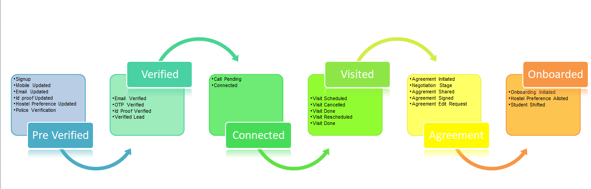
Appendix
Process Chart of the Sales Funnel

